Slide 1


Practical Update on Molecular Classification of Endometrial Cancer
Joseph Rabban MD MPH
Professor
Director of Gynecologic Pathology
UCSF Pathology Department
Joseph.Rabban@ucsf.edu

Slide 2
Outline of Talk
Summary of TCGA Classification of Endometrial Cancer
Practical Issues in Assigning Molecular Classification
Emerging Health Care Inequity in Tumor Classification

Slide 3

Traditional Approach to Pathologic Reporting of Endometrial Cancer
3 Objectives
1. Estimate prognosis
2. Refine adjuvant therapy decisions
3. Assess risk for genetic syndromes

Slide 4
Traditional Approach to Pathologic Reporting of Endometrial Cancer
3 Components
Morphologic classification
Stage
Lynch syndrome screening
Histotype
Grade
Lymphovascular space invasion

Slide 5
2024 Approach to Pathologic Reporting of Endometrial Cancer
Morphologic classification
Stage
Lynch syndrome screening
Molecular classification
Histotype
Grade
Lymphovascular space invasion
New
New and unresolved
New and controversial
New and unresolved
TCGA molecular category
Non-TCGA classifiers (HER2, b-catenin, ER, tumor mutational burden)

Slide 6
Molecular Classification of Endometrial Cancer
Model | Categories
TCGA classification | POLE mutated Hypermutated Copy number-high / TP53 mutated Copy number-low
Non-TCGA classifiers | CTNNB1 mutation 1q gain/loss Tumor mutational burden HER2 amplification

Slide 7
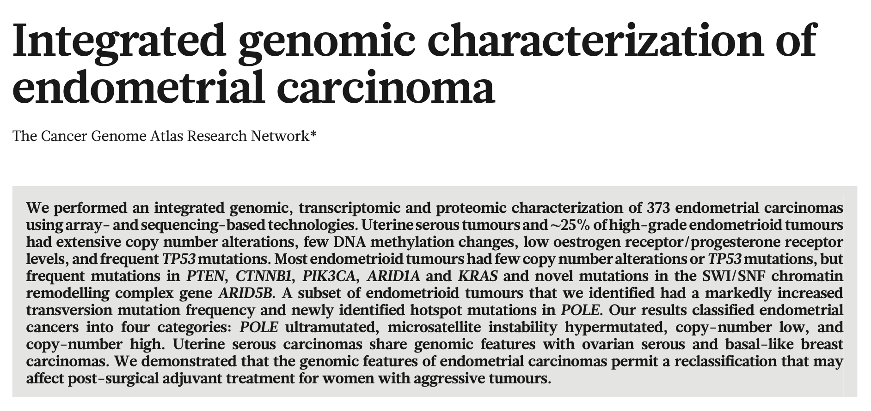

TCGA Classification of Endometrial Cancer
Nature. 2013; 497: 67-73. PMID 23636398

Slide 8



TCGA Classification of Endometrial Cancer
Summary of Study Design and Results
373 endometrial cancers
Histologic type
Grade
LVSI
Study was Agnostic to
Histopathology
Comprehensive
Genomic Analysis and Outcome Analysis
4 Molecular Classes,
Each Prognostically Unique
Independent of Histopathology
Multiple test platforms
Whole genome sequencing
Exome sequencing
Microsatellite instability testing
Copy number analysis (SNP microarray)
Nature. 2013; 497: 67-73. PMID 23636398

Slide 9
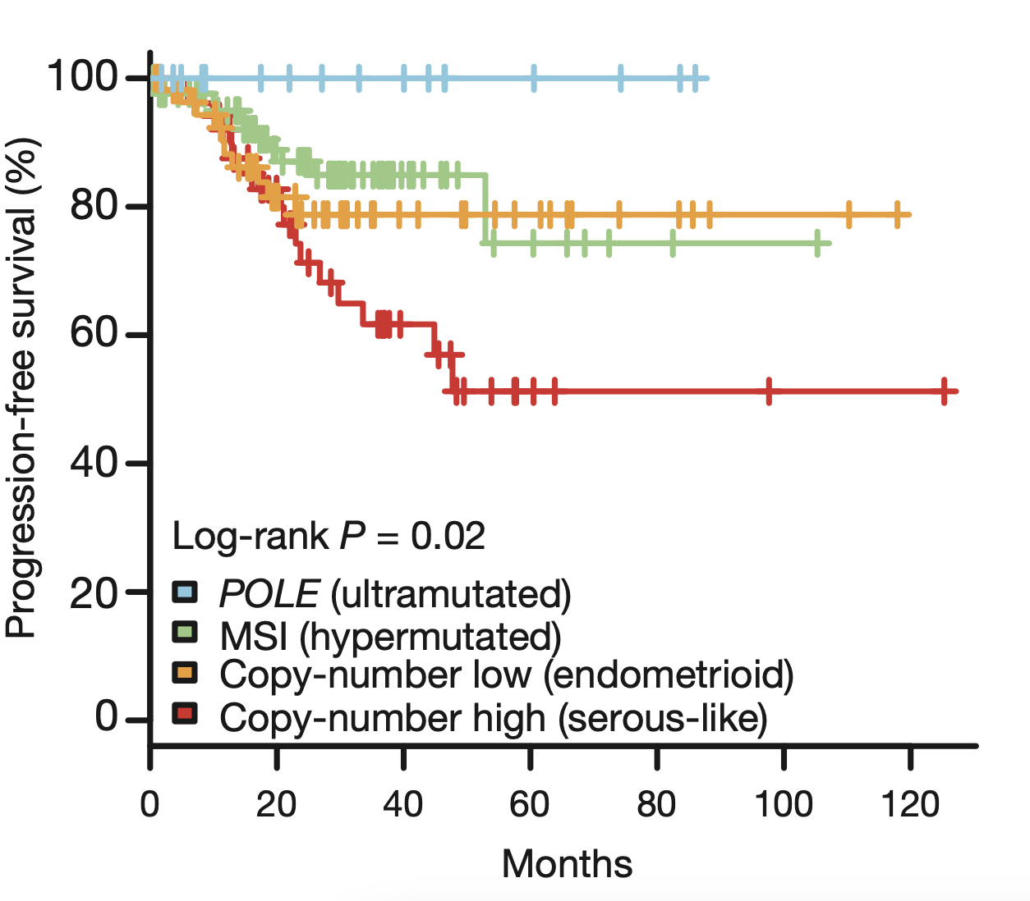
TCGA Classification of Endometrial Cancer
4 Molecular Categories of Prognostic Significance, Independent of Histotype/Grade/LVSI
POLE mutation: Ultramutated
Copy Number-Low
Microsatellite Unstable: Hypermutated
Copy Number-High (many are TP53 mutated)
Nature. 2013; 497: 67-73. PMID 23636398

Slide 10
TCGA Classification of Endometrial Cancer
Therapeutic Implications
Microsatellite Unstable: Hypermutated
Eligible for Immune Check-point Inhibitors
Nature. 2013; 497: 67-73. PMID 23636398

Slide 11
TCGA Classification of Endometrial Cancer
Therapeutic Implications
Copy Number-High (many are TP53 mutated)
Escalate Adjuvant Therapy Chemotherapy needs to be added to external beam radiotherapy
PORTEC-3 clinical trial PMID 32749941
Nature. 2013; 497: 67-73. PMID 23636398

Slide 12
TCGA Classification of Endometrial Cancer
Therapeutic Implications
POLE mutation: Ultra-mutated
De-escalate Adjuvant Therapy
Adjuvant therapy can be withheld, regardless of histotype, grade, LVSI
if stage I/II
PMID: 33793971
Nature. 2013; 497: 67-73. PMID 23636398

Slide 13
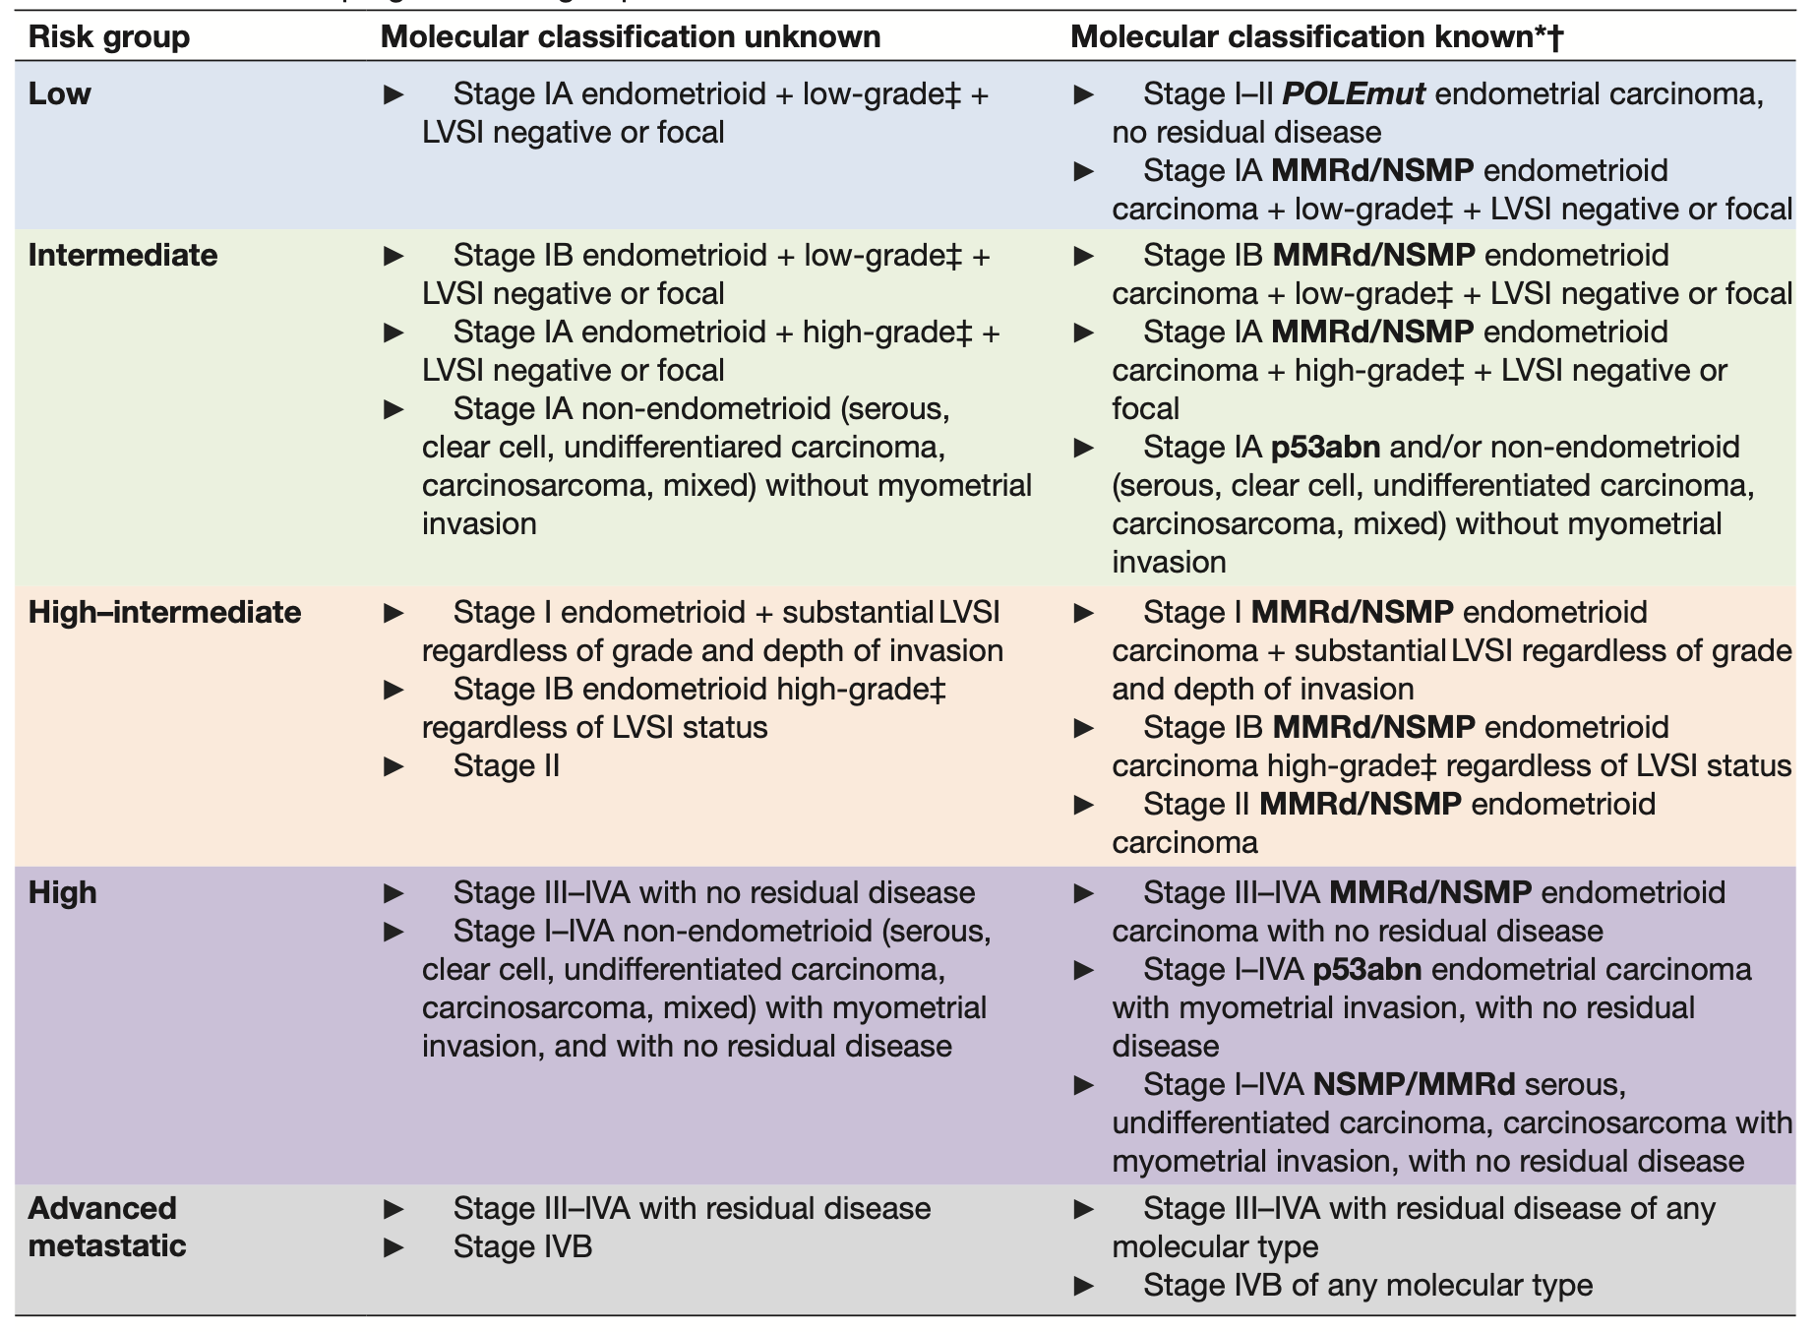
European Risk Groupings for Therapeutic Decision-making
Evidence-based guidelines
Consensus between European surgeons, pathologists and radiation oncologists
Groups are tied to treatment recommendations
NCCN guidelines are relatively similar
PMID: 33397713

Slide 14
2021 European Risk Groupings are Modified by TCGA Class
PMID: 33397713

Slide 15
Escalation of risk group if TP53 mutated
PMID: 33397713

Slide 16
De-escalation if POLE mutated
PMID: 33397713

Slide 17

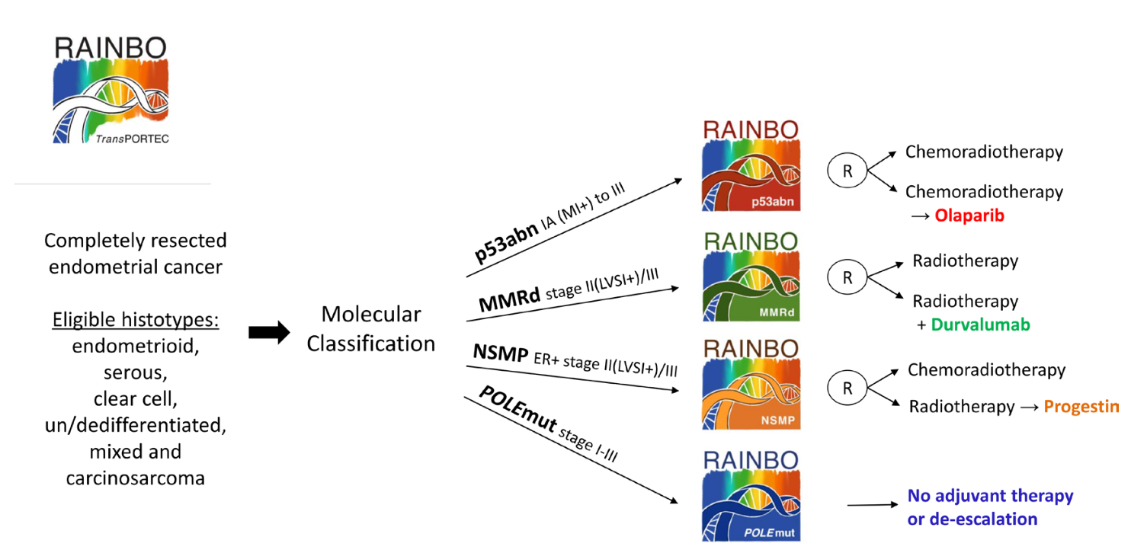
TCGA Classification of Endometrial Cancer
Prospective Randomized Clinical Trials Underway
Prospective randomized clinical trials
Arms based on TCGA category
International collaboration
Target 1,600 patients, results by 2028
Int J Gynecol Cancer. 2022 Dec 20;33(1):109-117. PMID: 36600534

Slide 18
TCGA Classification of Endometrial Cancer
What should be done today in the interim for pathological reporting endometrial cancer ?
Practical Questions for Daily Cases
Do all endometrial cancers merit TCGA classification, or only a subset ?
What biomarkers should be used for TCGA classification ? IHC, tumor sequencing ?
Competing Interests
Laboratory resources
Cost
Complexity of workflow for ordering, interpreting, reporting
Turn around time and patient care decision-making

Slide 19
TCGA Classification of Endometrial Cancer
Can morphology be used to define TCGA category ?
POLE
Wide spectrum of morphology/stage including high grade with extensive LVSI
CN-low
Endometrioid, clear cell, undifferentiated types
MSI-High
Endometrioid, clear cell, undifferentiated types
Serous, carcinosarcoma, g3 endometrioid
CN-high
Imperfect correlation with TCGA
Insufficient to reliably predict TCGA class
Nature. 2013; 497: 67-73. PMID 23636398

Slide 20
POLE mutated Endometrial Cancer
7.3% of endometrial cancers in TCGA study
POLE mutation in exonuclease domain hotspots
Unexpected, conflicting clinico-pathologic features
Best survival of all TCGA categories
Younger age
Lower body-mass-index
Low stage
“High grade” morphology
Endometrioid-like morphology
35% have aberrant p53 immunoexpression
LVSI positive

Slide 21
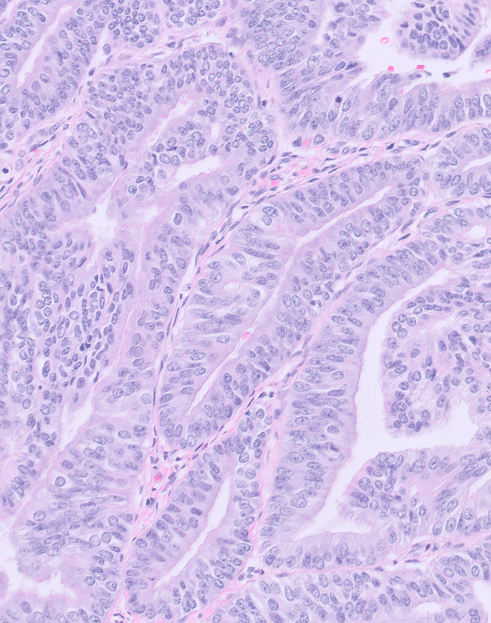
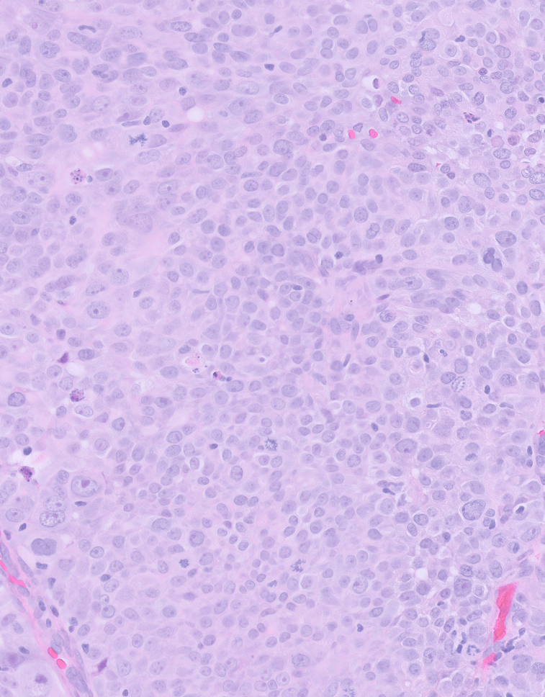
POLE mutated Endometrial Cancer
Grade 1 Endometrioid
Grade 3 Endometrioid

Slide 22
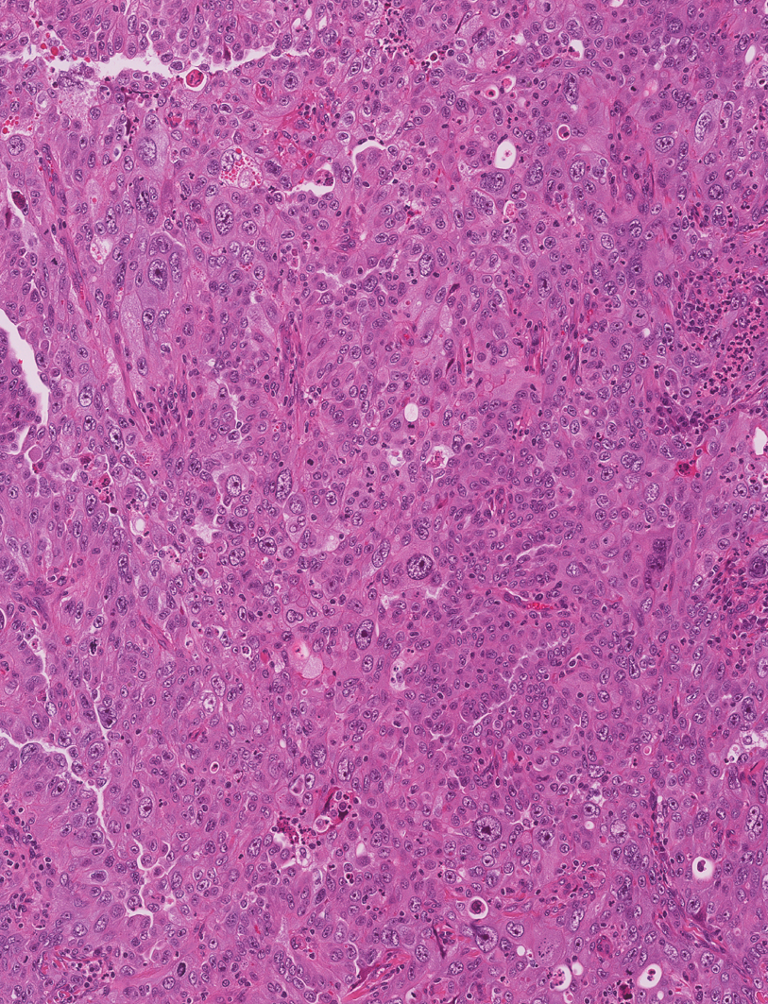
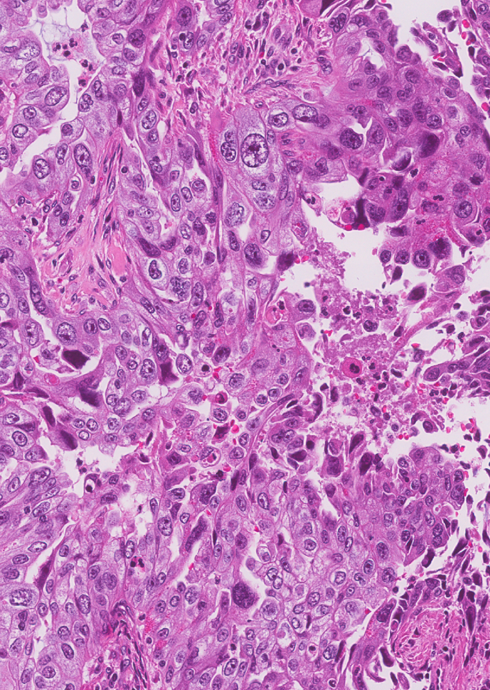
POLE mutated Endometrial Cancer
Ambiguous histotype Severe pleomorphism

Slide 23
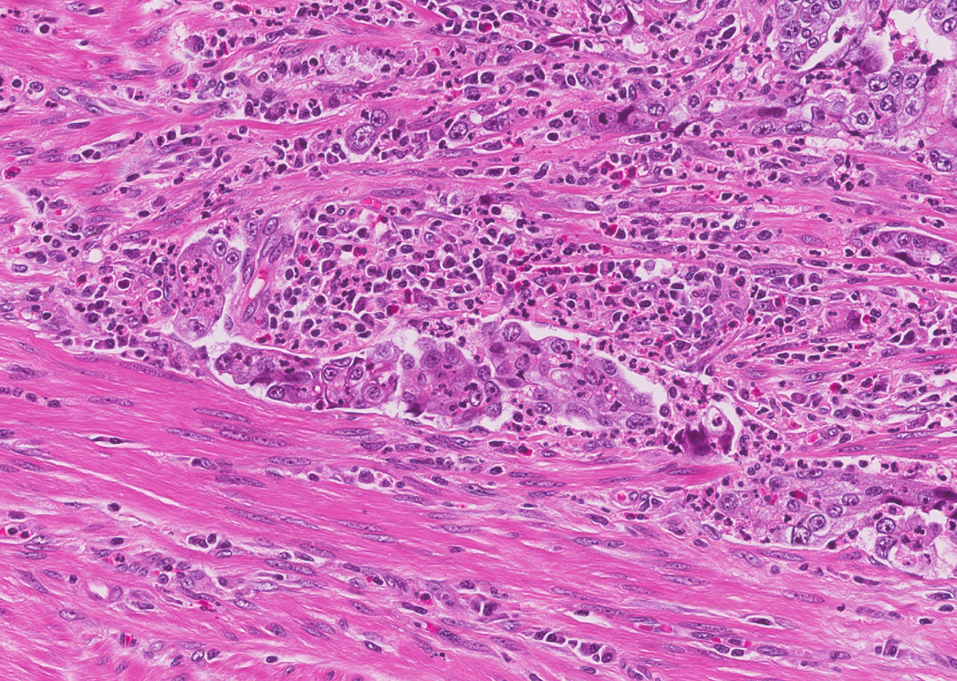
POLE mutated Endometrial Cancer
Tumor infiltrating lymphocytes

Slide 24
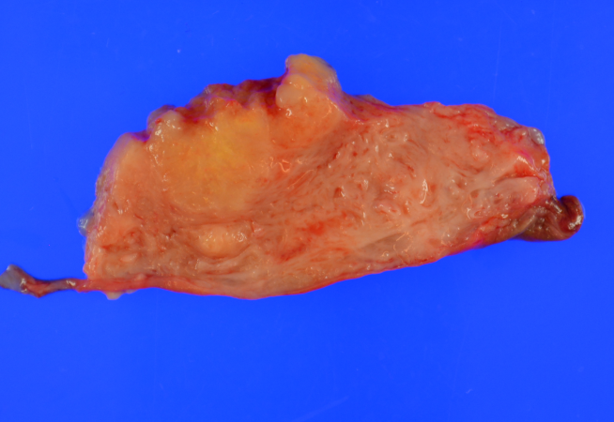

POLE mutated Endometrial Cancer
Deep Myoinvasion

Slide 25
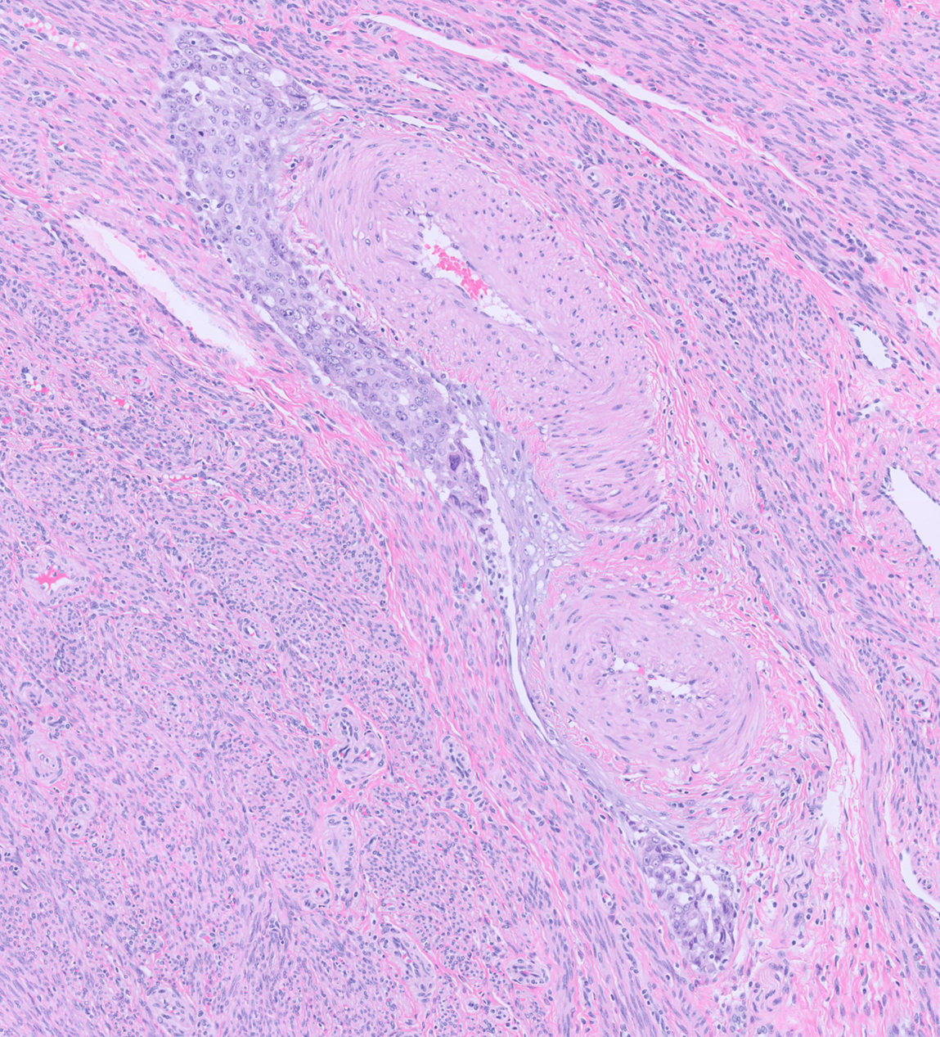
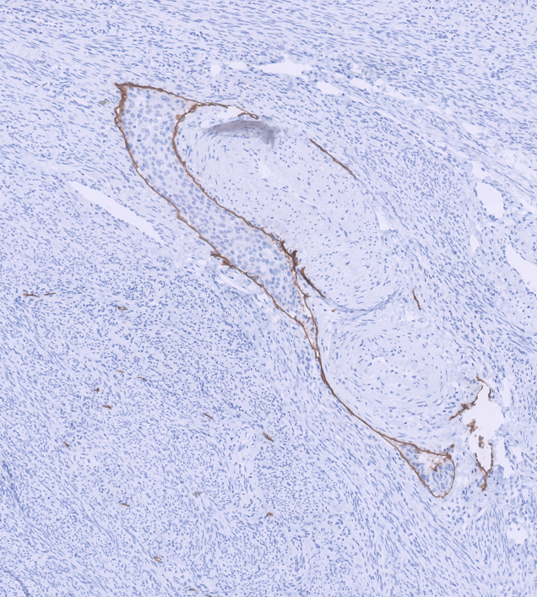
POLE mutated Endometrial Cancer
Lymphovascular Space Invasion
D240

Slide 26

POLE mutated Endometrial Cancer
Lymphovascular Space Invasion

Slide 27
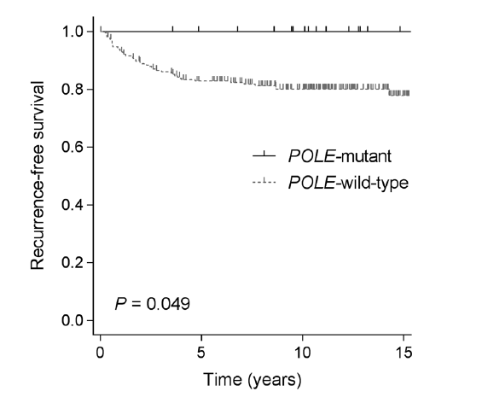
POLE mutated Endometrial Cancer
Better survival for POLE mutated cancers.
Prospective PORTEC-1 trial observational arm (no adjuvant therapy).
Van Gool et al. Clin Cancer Res. 2018;24:3197-3203

Slide 28
POLE mutated Endometrial Cancer
Reason for better survival ?
Currently not well understood
May be related to tumor immunogenicity
Early data suggests higher rates of:
Tumor infiltrating lymphocytes
PD-1 and PD-L1 immunoexpression
? Role for immune modulator therapy
Van Gool et al. Clin. Canc. Res. 2015; 21: 3347-3355.
Howitt et al. JAMA Oncol. 2015; 1: 1319-1323
Eggink et al. Oncoimm. 2016; 6: e1264565.
Bellone et al. Gynecol Oncol. 2017; 144: 146-152

Slide 29
Microsatellite Instability (Hypermutated) Endometrial Cancer
28% of endometrial cancers in TCGA study
Clinico-pathologic features
Intermediate long term behavior
40% of all endometrioid carcinomas
2% of all serous carcinomas
No other distinct features*
Morphology Predicting MMR-deficiency (not fully sensitive or specific)
Tumor-infiltrating lymphocytes
Peri-tumoral lymphocytes
Undifferentiated tumor morphology
Concurrent ovarian endometrioid/clear cell carcinoma
Lower uterine segment origin
Bartosch et al. Pathology. 2018; 50: 222-237

Slide 30
Copy Number Alteration-High Endometrial Cancer
26% of endometrial cancers in TCGA study
Clinico-pathologic features
Worst survival of all TCGA categories
Most were serous carcinoma or mixed carcinoma
94% of all serous carcinomas
62% of all mixed carcinomas
24% of grade 3 endometrioid carcinomas
TP53 mutation in 90%
ERBB2 (HER2) amplification in 25%

Slide 31
Copy Number Alteration-Low Endometrial Cancer
39% of endometrial cancers in TCGA study
Definition of “exclusion”:
Clinico-pathologic features
No POLE mutation
Microsatellite stable
Not CNA-high
Intermediate survival
Mostly endometrioid carcinoma
Wide range of grade, stage, LVSI

Slide 32
TCGA Classification of Endometrial Cancer
Does Morphology Predict TCGA Category ?
Not with any accuracy, other than that most serous carcinomas are CN-high

Slide 33
TCGA Classification of Endometrial Cancer
Can Immunohistochemistry be used to define TCGA category ?
POLE
No: need molecular test
CN-low
Category of exclusion
MSI-High
Yes: mismatch repair protein IHC
Yes: p53 IHC
Caveats:
    Not all CN-high have TP53 mutation
    TP53 mutation can occur in POLE and in MSI-high
CN-high
Nature. 2013; 497: 67-73. PMID 23636398

Slide 34
TCGA Classification of Endometrial Cancer
TP53 mutation can be a “passenger effect”, not linked to adverse outcome
POLE
may result in TP53 mutation
CN-low
MSI-High
may result in TP53 mutation
CN-high
Nature. 2013; 497: 67-73. PMID 23636398
PMID: 35752743

Slide 35
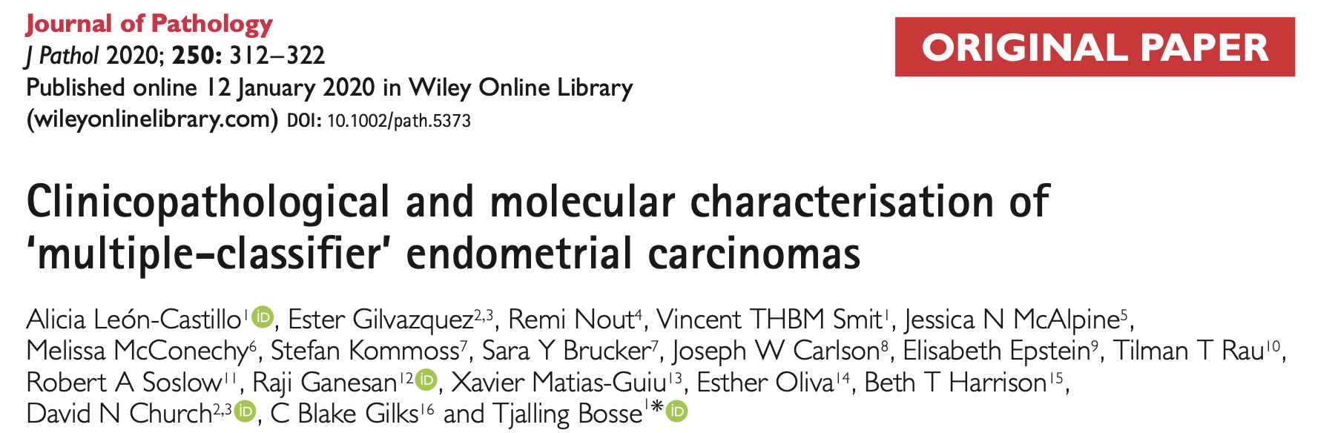
TCGA Classification of Endometrial Cancer
Tumors with Multiple Classifiers: How to Categorize ?
TP53 status | Concurrent Classifier | Overall Assignment of Molecular Category
Mutated | Copy Number-High | Copy Number-High
Mutated | POLE mutation | POLE mutation / Ultramutated
Mutated | Microsatellite Unstable | Microsatellite Unstable / Hypermutated
Mutated | Copy Number-Low | ? Unclear: ? Copy Number-Low
Recommendations based on this outcome study PMID 31829447
Endorsed by European consensus guidelines PMID: 33397713
PMID 31829447
35752743

Slide 36
Outline of Talk
Summary of TCGA Classification of Endometrial Cancer
Practical Issues in Assigning Molecular Classification

Slide 37
TCGA Classification of Endometrial Cancer
Surrogate Biomarkers
POLE mutation testing
Practical issues exist in
routine use in daily practice
MMR IHC; MSI PCR
p53 IHC

Slide 38
Testing for POLE mutation in Endometrial Cancer
Normal function of POLE | POLymerase Epsilon Repairs DNA replication errors
Effect of pathogenic POLE mutation | Massive tumor mutation burden >~100 mutations / million base pairs Referred to as “Ultra-mutated” tumor
Pathogenic mutations | Hotspots in exonuclease domain Mostly exons 9, 11, 13, 14
Testing options | Single gene sequencing Next generation sequencing panel PCR-based SNaPshot test 15 positions in exons 9, 11, 13, 14 PMID: 34907997

Slide 39

Testing for POLE mutation in Endometrial Cancer
Normal function of POLE | POLymerase Epsilon Repairs DNA replication errors
Effect of pathogenic POLE mutation | Massive tumor mutation burden >~100 mutations / million base pairs Referred to as “Ultra-mutated” tumor
Pathogenic mutations | Hotspots in exonuclease domain Mostly exons 9, 11, 13, 14
 | Single gene sequencing Next generation sequencing panel PCR-based SNaPshot test 15 positions in exons 9, 11, 13, 14 PMID: 34907997
Clinical utility: which patients to test? | Requires clinical trials to answer Most benefit to early stage patients
Barriers to access even in some high resource practices
PMID: 33793971

Slide 40
Testing for Microsatellite Instability / MMR defect in Endometrial Cancer
Normal function of MMR genes | Repair DNA replication errors Normal IHC expression of MLH1, PMS2, MSH2, MSH6 Microsatellite stable
Effect of pathogenic MMR mutation or epigenetic silencing of MLH1 | Significant tumor mutation burden > ~10<100 mutations / million base pairs Referred to as “Hyper-mutated” tumor
Testing options for MSI | PCR-based MSI test MSIsensor computational tool in NGS panel
Testing options for MMR IHC defect | 4 protein panel: MLH1, PMS2, MSH2, MSH6 2 protein panel: PMS2, MSH6 Pitfalls and Challenges: Sub-clonal loss Non-specific patterns in MMR-d (cytoplasmic, membranous, nucleolar) Punctate pattern artifact in MLH1 deficiency
PMID: 33290350

Slide 41
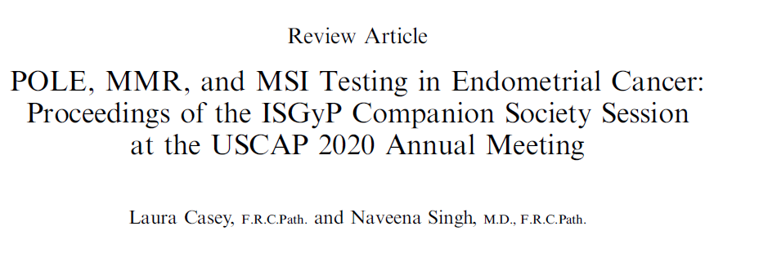

Testing for Microsatellite Instability / MMR defect in Endometrial Cancer
PMID: 33290350

Slide 42
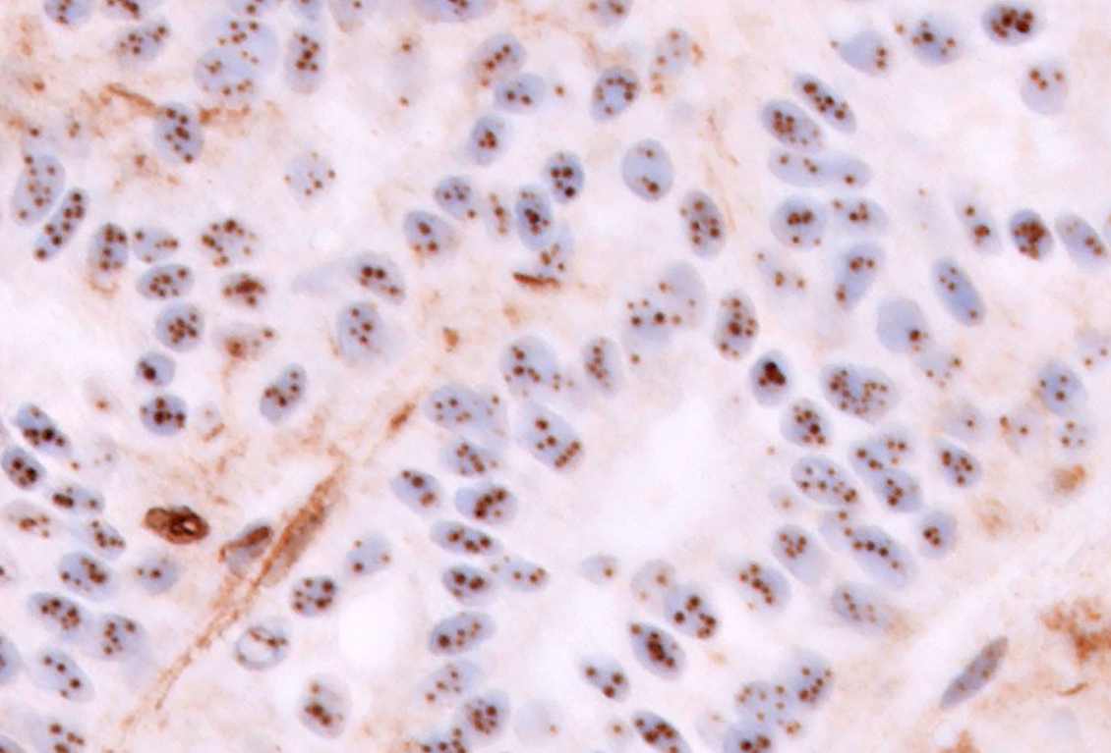
Punctate Pattern Nuclear Artifact in MLH1 deficient Endometrial Cancer
Bhardwaj et al.
Abstract 1376
2023 USCAP

Slide 43

Punctate Pattern Nuclear Artifact in MLH1 deficient Endometrial Cancer
Bhardwaj et al.
Abstract 1376
2023 USCAP

Slide 44
Punctate Pattern Nuclear Artifact in MLH1 deficient Endometrial Cancer
Rare: 7 published cases + 21 UCSF cases
All are MLH1 promoter methylated
All are PMS2 loss
No germline MMR mutations
Occurs with 3 different MLH1 clones
M1, ES05, GS168
Most prominent in biopsy specimens
Rare in hysterectomy specimens
Unclear mechanism
Bhardwaj et al.
Abstract 1376
2023 USCAP

Slide 45
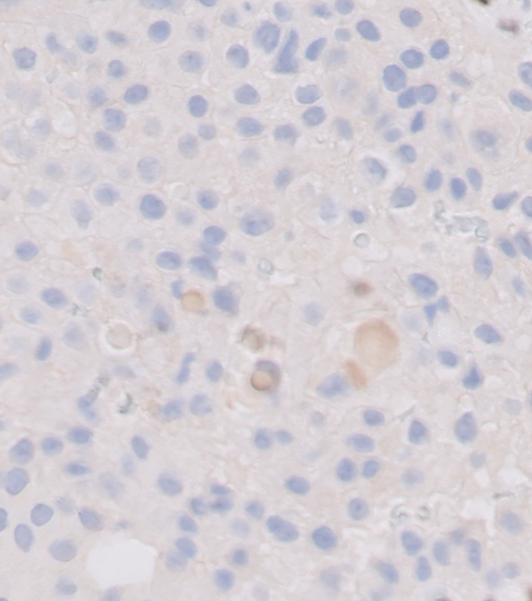
MLH1 PMS2
Pitfall Interpretation | Intact MLH1, Deficient PMS2 = likely germline PMS2 mutation
Correct Interpretation | Deficient MLH1, Deficient PMS2 = likely MLH1 promoter methylation

Slide 46
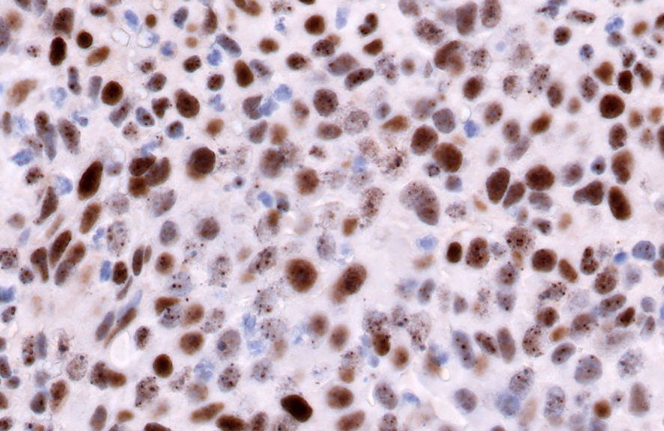
Punctate Pattern Mixed with Diffuse Nuclear Staining = Intact MLH1
Bhardwaj et al. Abstract 1376, 2023 USCAP

Slide 47

Testing for p53 aberrancy in Endometrial Cancer
IHC is a good correlate of mutation
if interpretation criteria and optimal titration are strictly applied
Mutation Type* | IHC Test Result | IHC Pattern | IHC Criteria
Missense | Aberrant | Overexpression | Uniform strong nuclear staining in >80% cells
Nonsense / frameshift |  | Null | Zero nuclear staining
Nuclear localization domain |  | Cytoplasmic | Diffuse cytoplasmic staining (+/- nuclear staining)
None | Wild type | Wild type | Variable distribution/intensity nuclear staining
*no outcome differences between mutation types
Consensus guidelines from International Society of Gynecological Pathologists
Int J Gynecol Pathol. 2019;38:S123-S131. PMID: 29517499

Slide 48
Testing for p53 aberrancy in Endometrial Cancer
PMID: 29517499

Slide 49
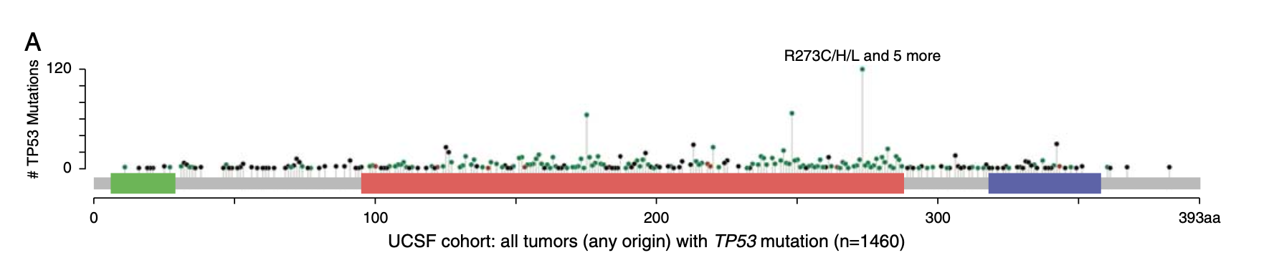
Most TP53 mutations affect DNA Binding Domain
Rarely, the Nuclear Localization Domain is involved,
leading to cytoplasmic accumulation of p53
Nuclear Localization
Domain
Transactivating Domain
DNA Binding Domain
Figure from PMID: 33899789

Slide 50
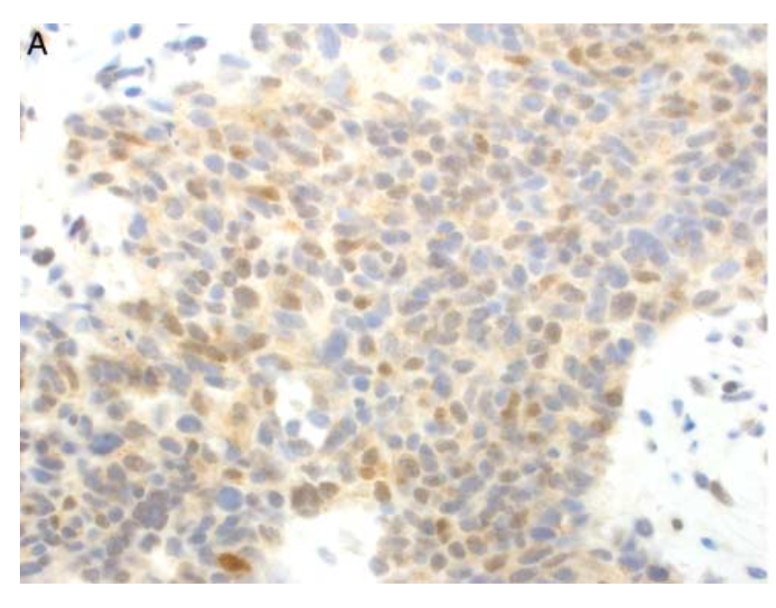
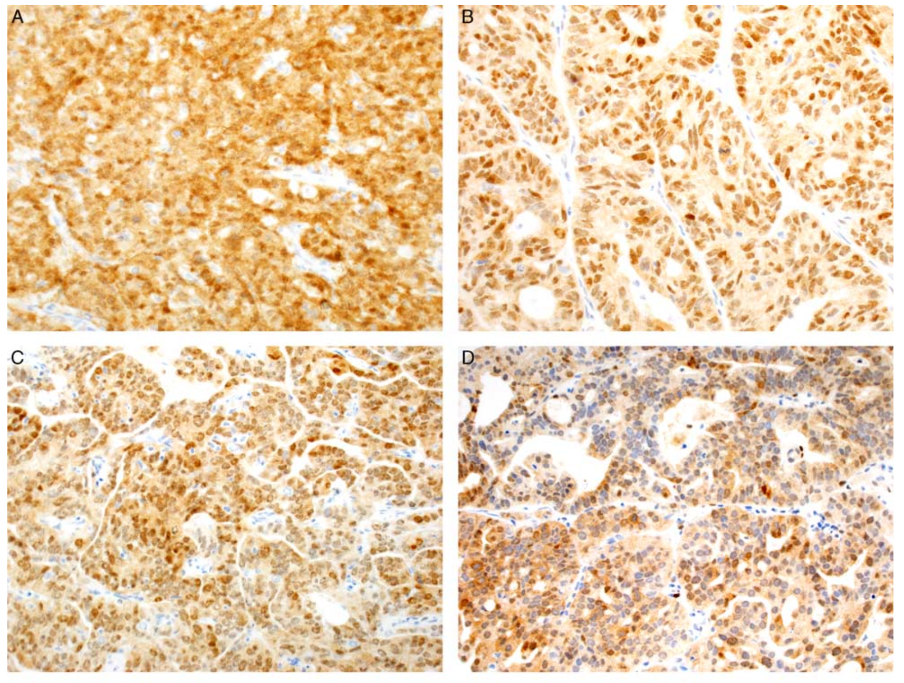
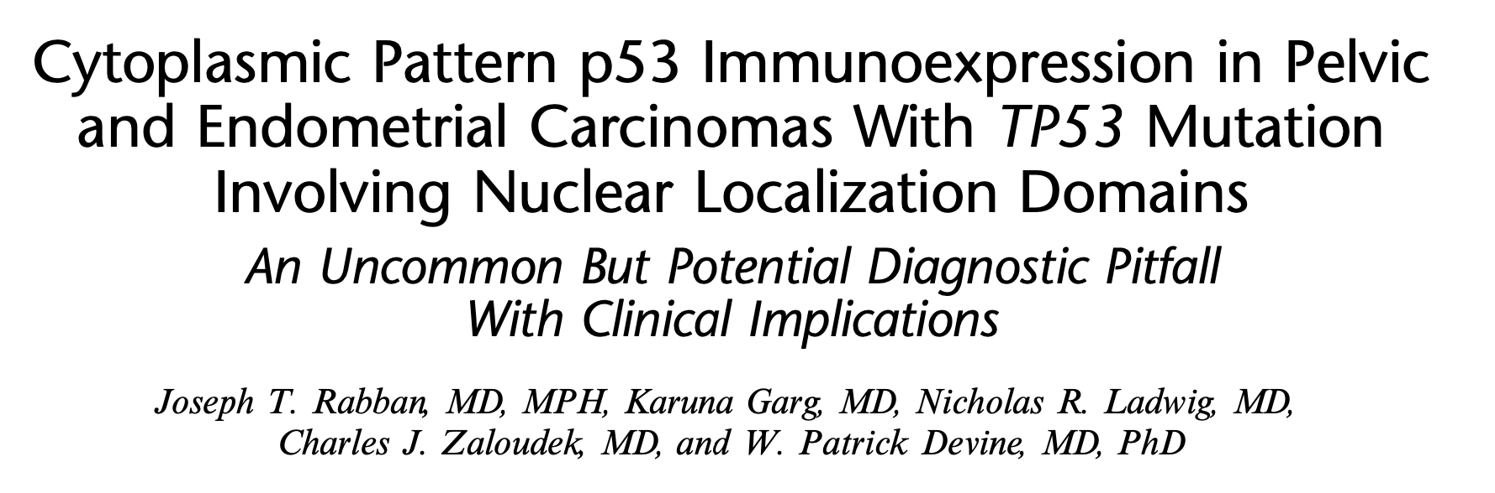
Cytoplasmic pattern p53 aberrant IHC
Potential Pitfall: May mimic “wild type” result
PMID: 33899789

Slide 51
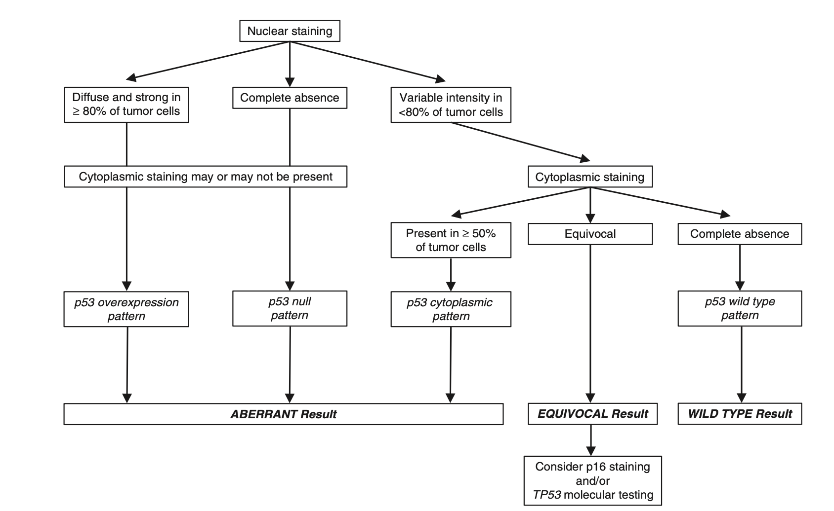
Structured Approach to p53 IHC Interpretation
PMID: 33899789

Slide 52
Testing for p53 aberrancy in Endometrial Cancer
Sub-clonal pattern of aberrant staining
Definition: Aberrant IHC pattern in a sharply defined zone comprising 10-80% of overall tumor cells stained
Remainder of tumor shows wild type IHC pattern
Uncommon pattern (~5% of cases)
Usually occurs in setting of POLE mutation or MSI-high
    Behaves as POLE or MSI-high (if those alterations are present)
PMID: 35752743

Slide 53
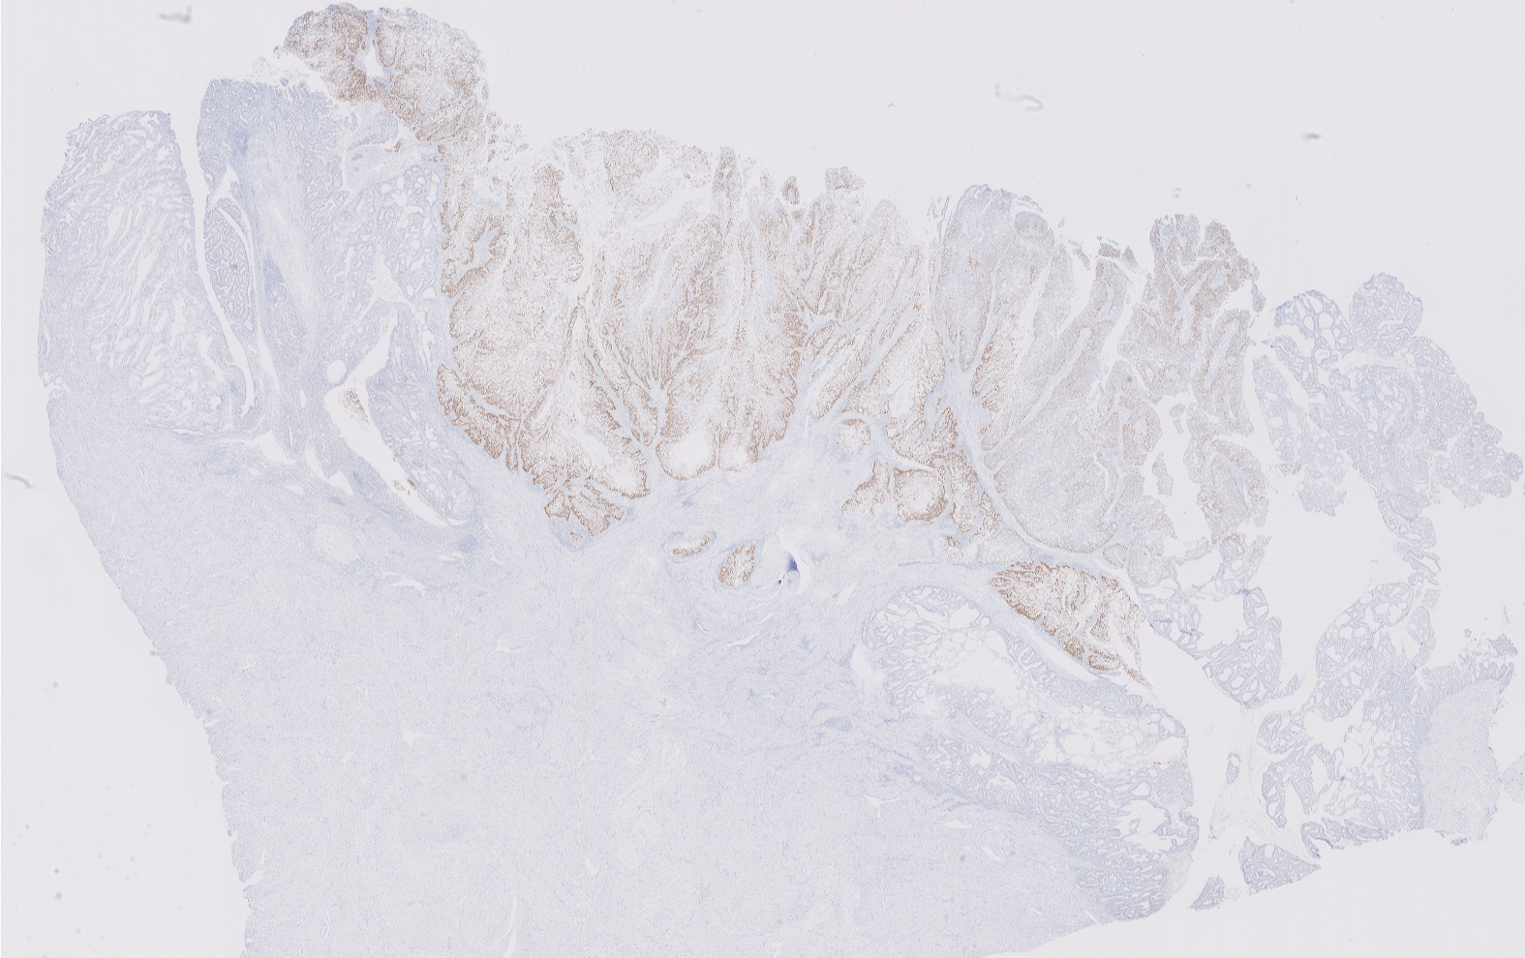
Sub-clonal pattern of aberrant p53 staining

Slide 54
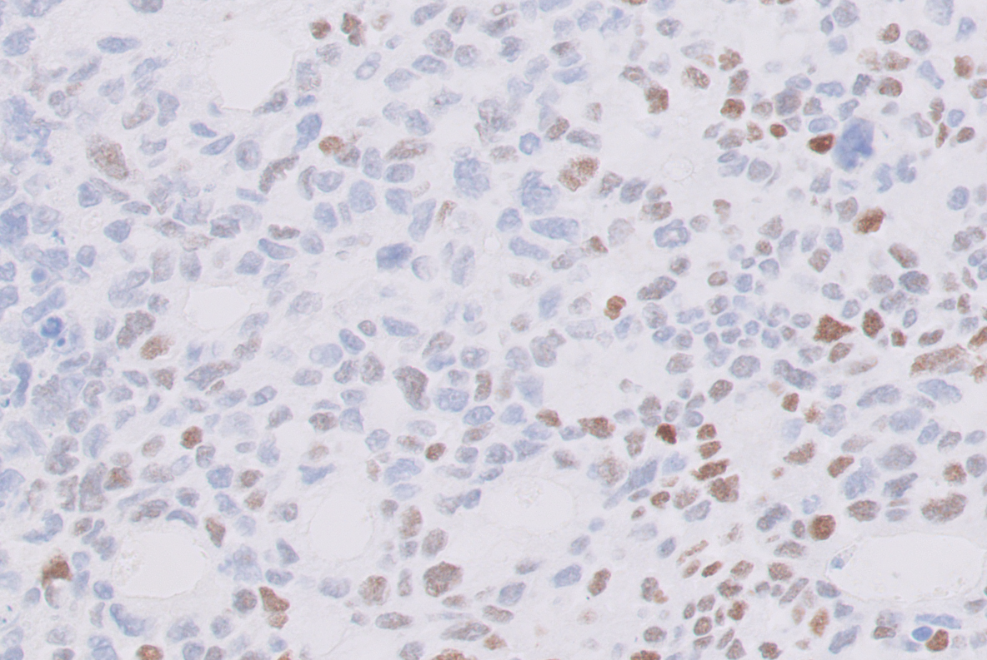
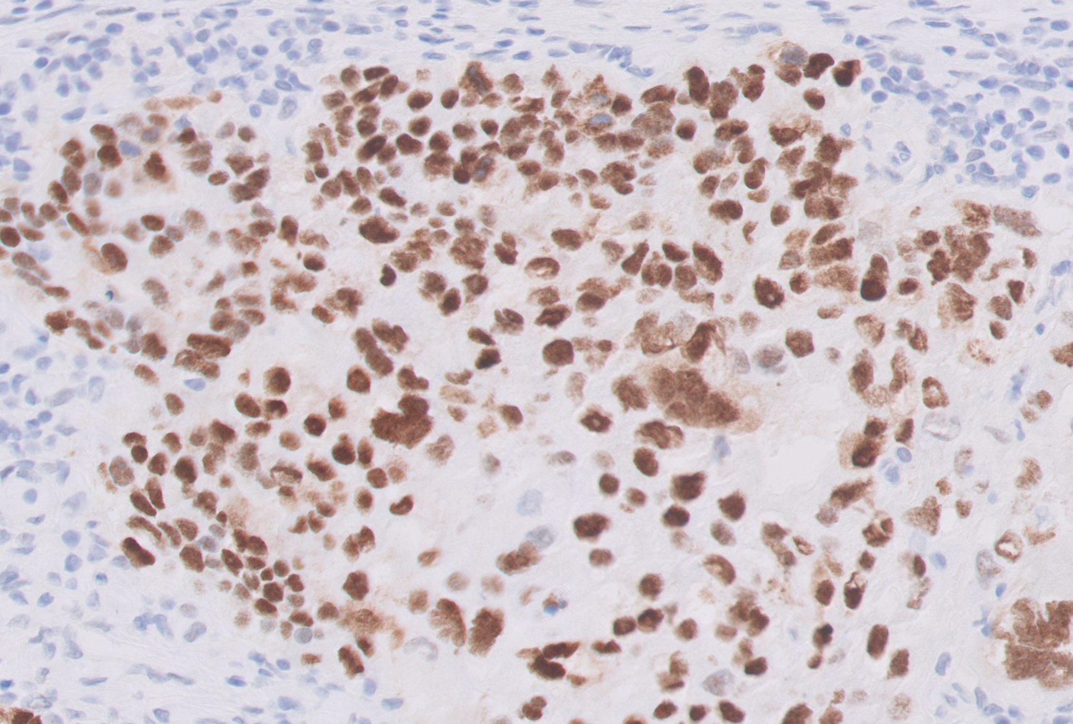
Sub-clonal pattern of aberrant p53 staining
Wild type pattern
Overexpression pattern
Wild type pattern

Slide 55
Testing for p53 aberrancy in Endometrial Cancer
Sub-clonal pattern of aberrant staining
Practical Approach to Reporting:
Confirm the result:
Assess validity of wild type p53 IHC result in internal/control tissue
Consider repeating p53 IHC on a different block
Double check that at least 10% of tumor shows the sub-clonal pattern
Reporting:
Terminology: sub-clonal aberrant p53 result
Comment that behavior more aligned with MSI-high or POLE mutation, if either present
PMID: 35752743

Slide 56
How to Integrate TCGA Classification in Reporting Endometrial Cancer ?
A Major Dilemma
POLE mutation status is required to assign TCGA classification
POLE

Slide 57
How to Integrate TCGA Classification in Reporting Endometrial Cancer ?
Is It a Required Reportable Variable ?
Organization | Current Position
WHO Classification of Female Genital Tumors | Not required
International Collaboration on Cancer Reporting
College of American Pathologist’s cancer checklist protocol
NCCN Guidelines
AJCC staging
FIGO staging
But growing interest amongst clinicians in specialty care centers

Slide 58
TCGA Classification of Endometrial Cancer
Best Strategy for Patient Section Remains to be Defined
Possible Strategies | Details
1. Reflex-based testing | Stepwise testing based on sequential test results
2. Risk group-based testing | POLE testing only in patients whose care would be changed by the status of POLE
3. Universal testing | Test every patient

Slide 59
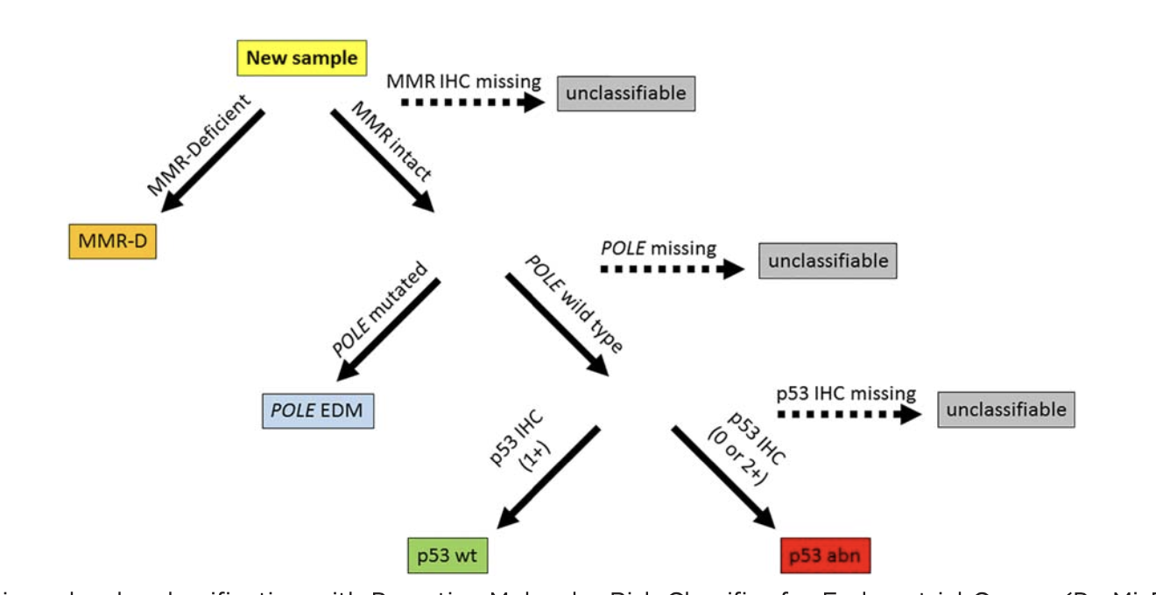
TCGA Classification of Endometrial Cancer
Best Strategy for Patient Section Remains to be Defined
“Reflex-based” Testing Strategy: ProMisE Proactive Molecular Risk Classifier for Endometrial Cancer
Figure from PMID: 28061006

Slide 60
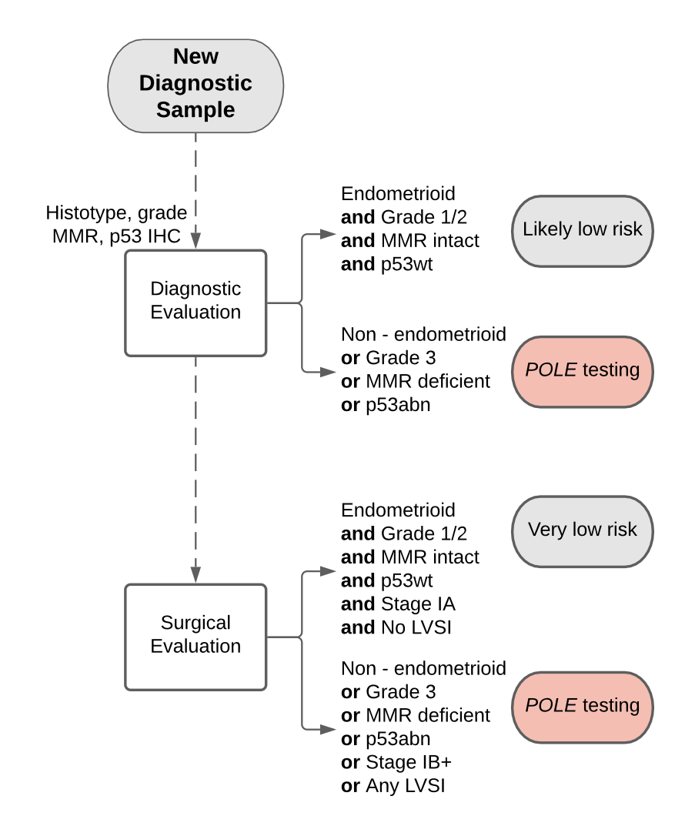
TCGA Classification of Endometrial Cancer
Best Strategy for Patient Section Remains to be Defined
Risk Group-based Testing
Figure from PMID: 36731023
Figure from www.bagp.org

Slide 61
TCGA Classification of Endometrial Cancer
Best Strategy for Patient Section Remains to be Defined
Universal Testing
Possible Strategies
1. Universal IHC [MMR+p53] and stand-alone POLE mutation testing
2. Universal next generation sequencing (no IHC)

Slide 62
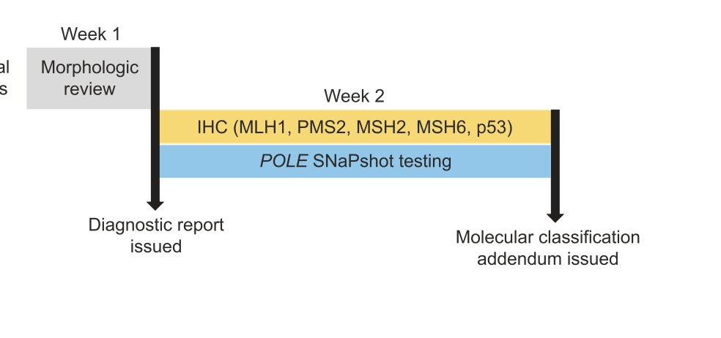
TCGA Classification of Endometrial Cancer
Best Strategy for Patient Section Remains to be Defined
Universal Testing with IHC + stand-alonePOLE test
Figure from PMID: 34743187

Slide 63
TCGA Classification of Endometrial Cancer
Rationale for Universal Next Generation Sequencing
…going “beyond” just TCGA
Endpoints | Advantages
TCGA classification | Overcomes problems with MMR, p53 IHC interpretation
Assess for Lynch syndrome risk | Direct MMR gene evaluation (distinguish somatic vs genomic)
Beyond TCGA:
Non-TCGA classifiers | CTNNB1, 1q alterations, tumor mutational burden
Assess for non-Lynch syndromes | e.g. breast/ovarian cancer syndrome (BRCA1/2, CHEK2)
Identify targetable alterations | FDA approved targeted therapy or clinical trial entry

Slide 64
TCGA Classification of Endometrial Cancer
Rationale for Universal Next Generation Sequencing
Disadvantages
Expensive
Resource-intensive (lab, staffing)
Complex workflow / reporting
Clinical utility remains to be studied

Slide 65
UCSF Pilot Workflow for Universal NGS of Endometrial Cancer
Developed at request of gyn oncologists and genetic counseling division
Universal testing of all endometrial carcinomas on hysterectomy specimen, no exclusions
Reporting
Correlation
UCSF500 Test NGS Platform
500+ gene panel
Copy number analysis
Tumor mutational burden analysis
MSIsensor (85 microsatellites)
Molecular pathologist assigns TCGA category in NGS report
Surgical pathologist adds integrated summary to hysterectomy report via addendum
Biweekly molecular/surgical pathology correlation conference to review all cases

Slide 66
Test Workflow at UCSF
Endometrial Carcinoma
(all ages, histotypes, grades, stages)
Recent changes to the original workflow shown
Testing is tumor + normal (when consent provided)
HER2 testing is for all grade 3 p53 aberrant / TP53 mutated cancers agnostic to histotype / stage / LVSI
Next Generation Sequencing
Yes
MMR gene alterations
No
MSIsensor results
MSI-High or Equivocal
MS Stable
MLH1 Promoter Methylation Test
Negative
Positive
Refer to Genetic Counseling
No Referral to Genetic Counseling
Issue Integrated Summary via Addendum To Hysterectomy Report
(in addition to stand alone NGS Report)
No
Serous Carcinoma
Yes
HER2 Test
IHC / FISH

Slide 67
Specimen Availability and Testing
Biopsy confirmed endometrial carcinoma
(consecutive cases)
N=416
Hysterectomy Performed ?
Yes
N=392
No
N= 24
Adequate Tumor in Hysterectomy Specimen ?
Deferred due to advanced stage disease
N=17
Deferred due to fertility sparing therapy
N=2
Fertility-sparing therapy currently underway
N= 2
Yes
N=360
No
N=32
Patient death before hysterectomy performed
N= 1
In-house specimen of endometrial biopsy available ?
In-house specimen of endometrial biopsy or
distant disease available ?
Yes
No
Yes
No
Hysterectomy delayed due to medical co-morbidities
N= 1
Block available from outside specimen of endometrial biopsy ?
Block available from outside specimen of endometrial biopsy ?
Yes
No
Yes
No
Patient lost to follow up after biopsy performed
N= 1
N=0
N=0
NGS performed on hysterectomy specimen
N= 360*
NGS performed on endometrial biopsy
(in-house specimen)
N= 21
NGS performed on endometrial biopsy
(outside specimen)
N= 11
NGS performed on endometrial biopsy
(in-house specimen)
N= 10
NGS performed on distant disease (in-house specimen)
N= 7
NGS performed on endometrial biopsy
(outside specimen)
N= 2
NGS
not performed
on any specimen
N=5
* 1 patient did not have enough tumor DNA for sequencing in the hysterectomy or in the biopsy

Slide 68









Refinement of Risk Grouping
UCSF Pilot Experience
ESGO/ESTRO/ESP Risk Group
Based on Pathologic Criteria Alone
ESGO/ESTRO/ESP Risk Group
After Integrating TCGA Classification
Low Risk
N=198
96.5%
Low Risk
N=198
3.5%
7.1% 19.7% 3.5% 69.7% 10.6% 19.7% 69.7%
Intermediate Risk
N=70
4.3%
Intermediate Risk
N=68
87%
8.6%
4.3% 20% 30% 45.7% 20.6% 32.4% 47.1%
High Intermediate Risk
N=26
15.4%
61.5%
High Intermediate Risk
N=16
23.1%
15.4% 34.6% 26.9% 23.1% 56.3% 6.3% 37.5%
High Risk
N=75
High Risk
N=87
100%
2.7% 33.3% 42.7% 21.3% 2.3% 28.7% 50.6% 18.4%
Advanced
N=41
Advanced
N=41
100%
2.4% 14.6% 48.8% 34.1%
2.4% 14.6% 48.8% 34.1%
POLE mutated
MSI High
CN High
CN Low
De-escalate only stage I/II POLE mutated cases
Escalate only TP53 mutated cases that are MS-Stable, POLE wt

Slide 69
UCSF Pilot Experience
Clinical Utility of POLE Mutation Status
Percentage of all POLE mutated cases eligible for consideration of de-escalation of adjuvant therapy
Percentage of all intermediate and high-intermediate risk group cases with POLE mutation
Caveat: 9% of low risk group were TP53 mutated / CN-low / MS-Stable, a subset of which were POLE mutated
68% 32%
NO YES
8% YES
92%
NO

Slide 70
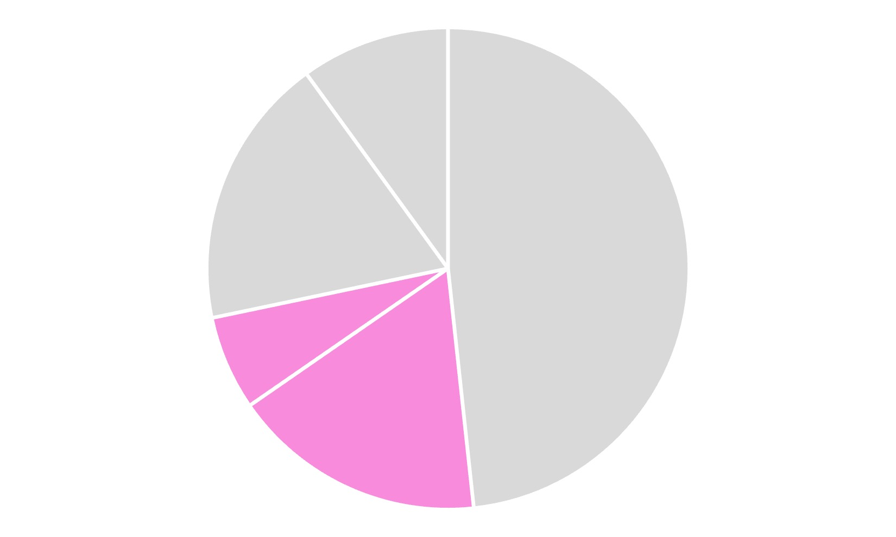
UCSF Pilot Experience
Clinical Utility of POLE Mutation Status
Percentage of all endometrial cancer cases that benefit from POLE mutation testing
Suggests that selective POLE testing may be more justified than universal POLE testing
TP53 mut, MSS, CN-Low
Low Risk
Intermediate Risk
~28% of all cases
High-Intermediate Risk
Advanced Risk
High Risk

Slide 71
UCSF Pilot Experience
Utility of NGS Beyond TCGA Classification
Incidental Detection of Hereditary Cancer-Associated Pathogenic Variants Other than Lynch
 | Hereditary Breast/Ovarian Cancer Genes
CN-low | 7%
CN-high | 16%
MSI-High | 41%
POLE mutated | 79%
Refer to genetic counseling service
Identification of Targetable Alterations (FDA-approved therapies or clinical trials)
 | Actionable Alteration
CN-low | 100%
CN-high | 75%
POLE mutated | 100%
MSI-high | 100%

Slide 72
TCGA Classification of Endometrial Cancer
Key Questions that Remain:
How does NGS compare to IHC + POLE testing ?
    From a patient benefit perspective
    From a financial perspective
Should testing be universal versus selective ?
How do we define best practices for patients in limited resource environments ?

Slide 73
Outline of Talk
Practical Solutions to Controversies in
Assigning tumor histotype
Assigning molecular classification
    TCGA classifiers
    Non-TCGA classifiers
        HER2
        Estrogen receptor
        B-catenin
        TMB

Slide 74
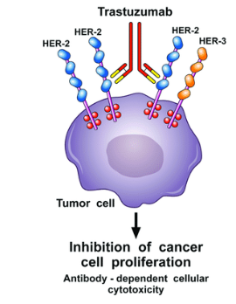
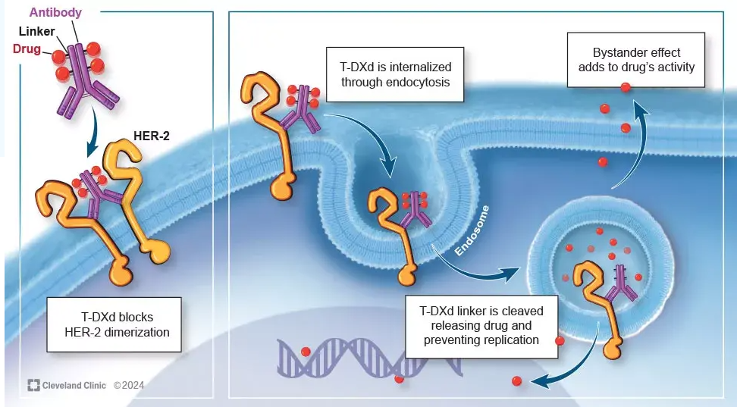
HER2 Status in Endometrial Carcinoma
A Marker of Eligibility for 2 Drugs
Trastuzumab
Trastuzumab deruxtecan
PMID: 29563880
https://consultqd.clevelandclinic.org/real-world-use-of-trastuzumab-deruxtecan

Slide 75
HER2 Status in Endometrial Carcinoma
A Marker of Drug Eligibility
Clinical Context | Drug | Result that Predicts Response to Drug | Interpretation Criteria for HER2 | PMID
Stage III/IV endometrial serous carcinoma | Trastuzumab | 3+ IHC 2+ IHC then FISH positive | ISGyP “serous carcinoma” critiera | 32601075, 29584549
Recurrent endometrial carcinosarcoma | Trastuzumab | At least 1+ IHC | ISGyP “serous carcinoma” criteria | 29584549
Advanced stage / metastatic endometrial carcinoma (any type) | Trastuzumab deruxtecan (antibody drug conjugate) | At least 1+ IHC | CAP “gastric carcinoma” criteria | 37870536

Slide 76
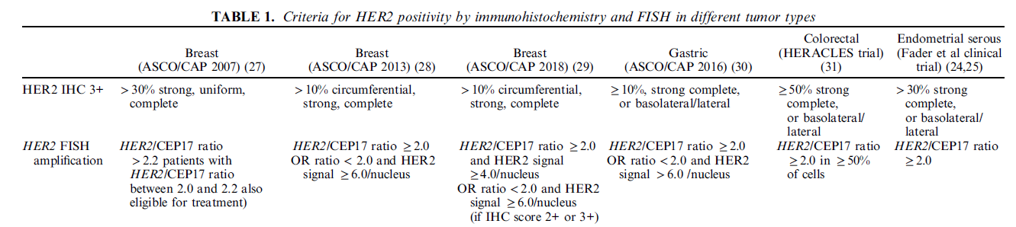
4 Different Systems for Interpreting HER2 Status by IHC and FISH
PMID: 33290351

Slide 77
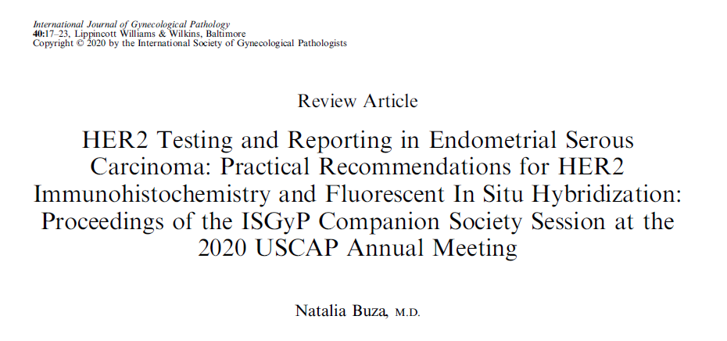
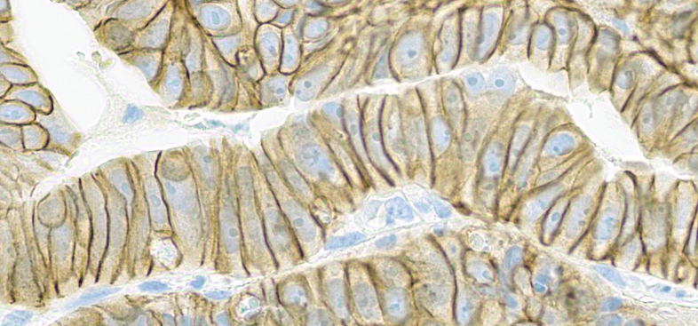
HER2 IHC Interpretation Criteria for Endometrial Serous Carcinoma
ISGyP Recommendations
PMID: 33290351
Lateral membrane staining

Slide 78
HER2 Testing in Endometrial Carcinoma
Practical Approach to an Evolving Issue
Not a current requirement by any US organization
Current UCSF approach for pathologist-initiated testing:
Testing indications | All high grade p53 aberrant carcinomas (all histotypes, all stages)
Test platform | HER2 IHC Reflex to HER2 FISH if IHC 2+
Interpretation criteria (evolving topic) | Default: ISGyP serous carcinoma criteria PMID: 33290351 On request: CAP gastric cancer criteria

Slide 79
Other Classifiers in Endometrial Carcinoma
Estrogen receptor IHC
B-catenin IHC
Tumor mutational burden (from NGS panel)
Evolving, controversial, unresolved literature
Not required by US organizations
PMID: 33290351

Slide 80
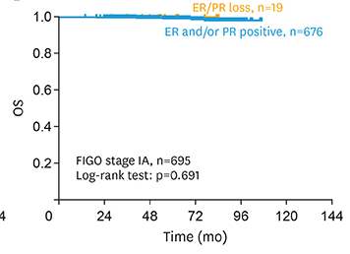
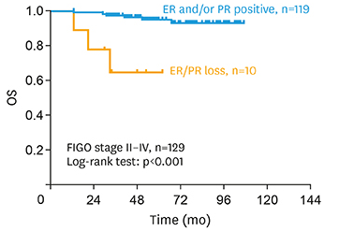
Other Classifiers in Endometrial Carcinoma
Estrogen/progesterone receptor IHC In low grade endometrioid carcinoma
Stage I Stage >I
J Gynecol Oncol. 2019 Jan;30(1):e13.

Slide 81
What Biomarkers to Report in Endometrial Carcinoma
if you have no access to POLE testing
My personal view, acknowledging this continues to be an evolving question
Setting | Testing
All cases (all histotypes, all grades, all stages) | Mismatch repair protein IHC
 | p53 IHC
 | ER
High grade p53 aberrant cancers (all histotypes, stages) | HER2 IHC (by clinician request)

Slide 82
Outline of Talk
Summary of TCGA Classification of Endometrial Cancer
Practical Issues in Assigning Molecular Classification
Emerging Health Care Inequity in Tumor Classification

Slide 83

Access to the Resource Intensive Tests For Endometrial Cancer Classification
Is a Health Care Disparity in Treatment Emerging ?

Slide 84

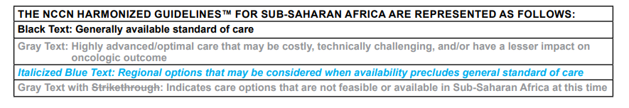
Definition of “Best Practices” for Care is Customized to Local Resources

Slide 85
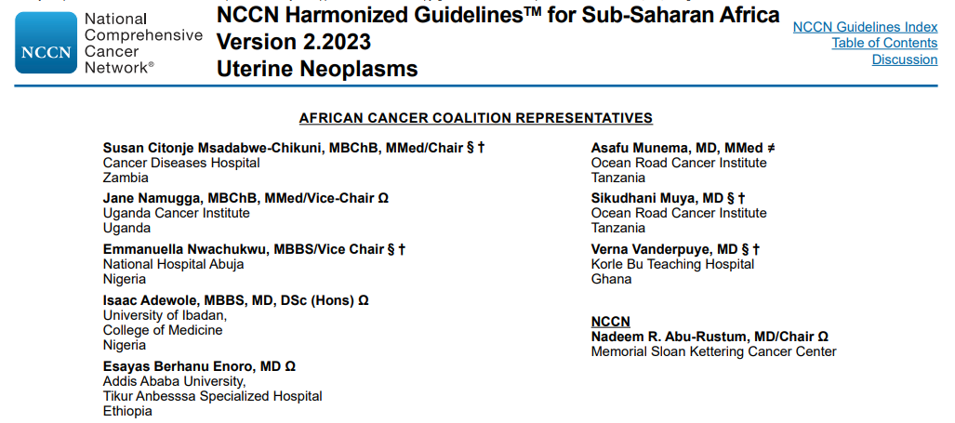
Pathologist

Slide 86


Slide 87
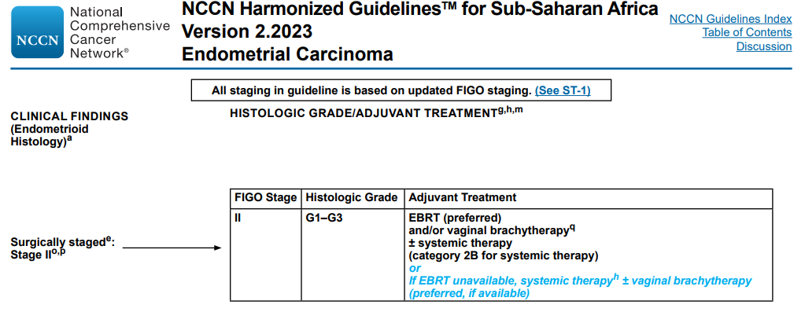

Slide 88

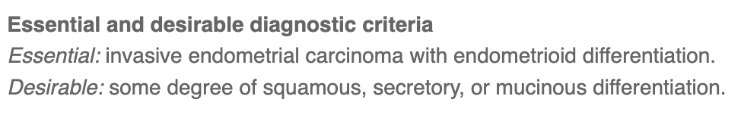
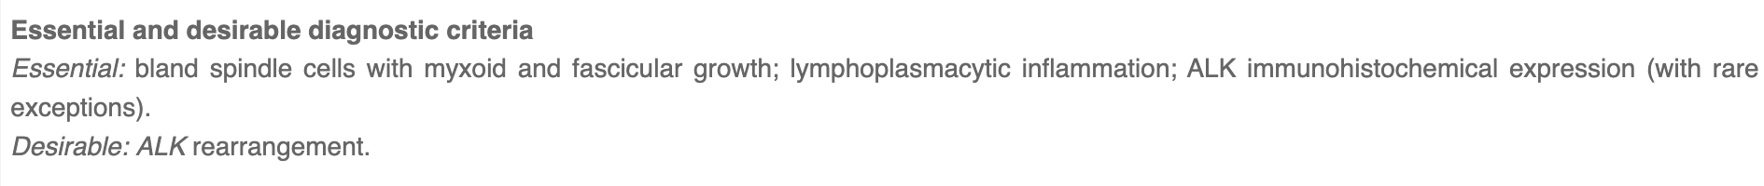
Is the 2020 WHO Classification System “Feasible” to Apply Across the Globe ?
Are “Essential Criteria” Globally Achievable ?
No biomarkers required:
Immunostain required:
Molecular test required:

Slide 89
Is the 2020 WHO Classification System “Feasible” to Apply Across the Globe ?
Are “Essential Criteria” Globally Achievable ?
Immunostain required:
36 different IHC are listed as required for “essential criteria”
Molecular test required:
7 different molecular tests are listed as required for “essential criteria”

Slide 90
Is the 2020 WHO Classification System “Feasible” to Apply Across the Globe ?
Are “Essential Criteria” Globally Achievable ?
Preliminary results of an international survey (445 responses, 72 countries)
 | Low/low middle income | High income
Total responses | 30% | 41%
No access to WHO blue book | 14% | 2%
Routine access to immunostains | 70% | 96%
Patient billed for immunostains | 60% | 3%
Routine access to p53 IHC | 85% | 99%
Routine access to MMR IHC | 63% | 97%
Routine access to POLE mutation test | 19% | 68%
Is a Health Care Disparity in Tumor Classification Emerging ? Answer seems to be “yes”
Presented at 2024 USCAP Annual Meeting

Slide 91
Is the 2020 WHO Classification System “Feasible” to Apply Across the Globe ?
Strategies to Close the Widening Gap of Health Care Inequity
Develop a funding mechanism to make WHO blue book accessible to those in need
Develop alternate “morphology only”-based treatment guidelines (e.g. partner with NCCN)
Provide option of “morphology only” essential criteria WHO (expand the details/discussion)
Explore remote image analysis / AI technology based on “morphology only”

Slide 92
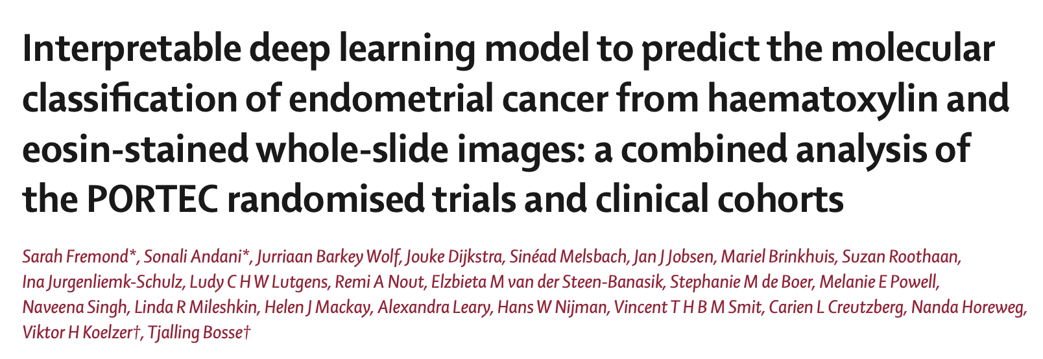
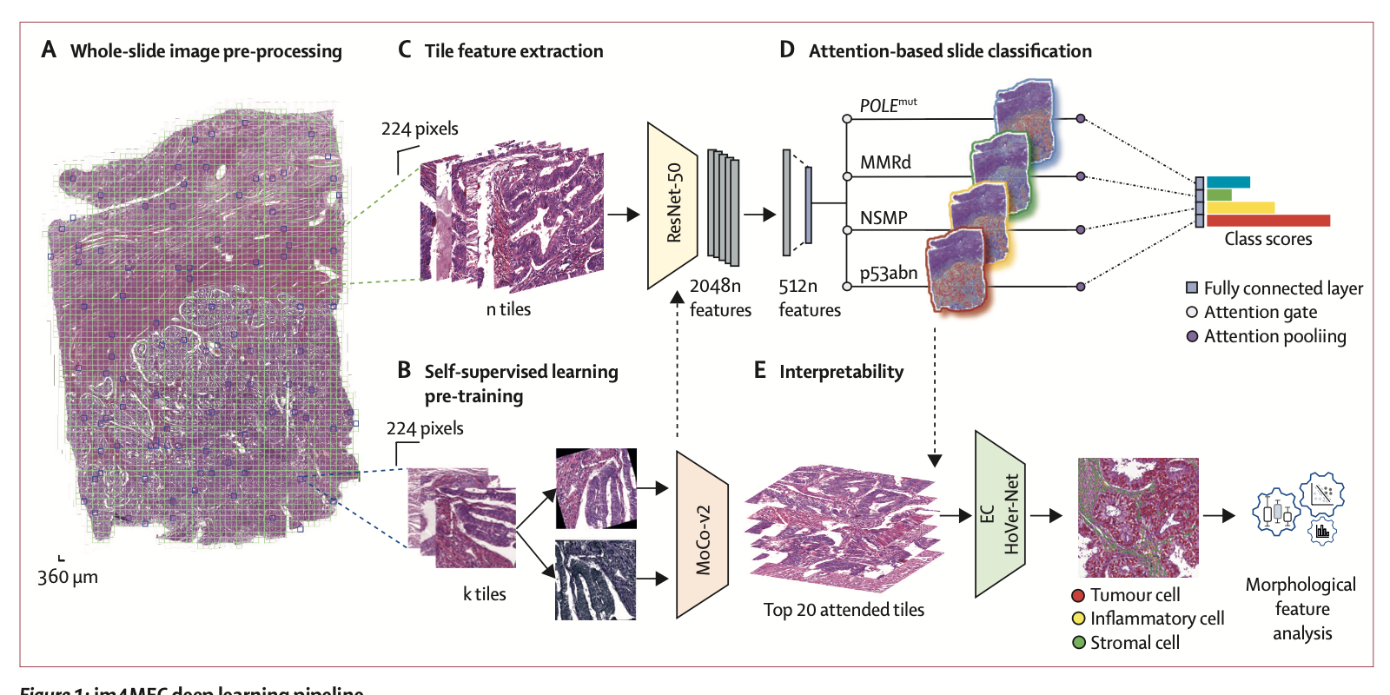
Can remote pathology and computational pathology side-step biomarkers ?
Lancet Digit Health. 2023;5:e71-e82. PMID: 36496303

Slide 93

Can remote pathology and computational pathology close the health care gap ?
The possibility seems reasonable to consider
Email digital images to central lab
TCGA category reported back

Slide 94

Outline of Talk
Summary of TCGA Classification of Endometrial Cancer
Practical Issues in Assigning Molecular Classification
Emerging Health Care Inequity in Tumor Classification

